Slide 1


Welcome
About Us
Our Teams
Agenda
Our Services
Achievements
Our Goals
Gallery
Pricing
Contact Us

Slide 2
Welcome
About Us
Our Teams
Analysis and Visualisation of Spotify Dataset
Agenda
Our Services
Achievements
Our Goals
A Music Recommendation system
Gallery
Pricing
Contact Us

Slide 3














01
SSSK
Our Team
Agenda
Introduction
Our Team
Aims and
Objectives
Dataset
EDA
Recommendation
System
Key Insights
Conclusion
Shitiz Agarwal
Shrey Agarwal
Shashvath Arun
Keegan Nunes
Future Scope
Artist
Artist
Artist
Artist

Slide 4


02
SSSK
Our Team
Agenda
Agenda
Introduction
Aims and
Objectives
Dataset
01
Introduction
05
Recommendation System
EDA
02
Aims and Objectives
06
Key Insights
Recommendation
System
Key Insights
03
Dataset
07
Conclusion
Conclusion
04
Exploratory Data Analysis
08
Future Scope
Future Scope

Slide 5

03
SSSK
Our Team
Agenda
Introduction
Introduction
Aims and
Objectives
A music recommendation system uses statistical models and Python frameworks to suggest songs based on user preferences, enhancing the benefits of music. It analyses attributes like genre and artist to recommend similar songs on platforms like Spotify and YouTube Music. Steps include data collection, data processing, data storage, algorithm creation, and testing. Finally, deployment involves using tools like Streamlit to create an app for real-world usage, recommending songs based on listening habits.
Dataset
EDA
Recommendation
System
Key Insights
Conclusion
Future Scope
Play
Follow

Slide 6


04
SSSK
Our Team
Agenda
Introduction
Aims and Objectives
Aims and
Objectives
Dataset
This project aims to develop a personalized music recommendation system that uses algorithms like collaborative and content-based filtering to suggest songs based on user preferences and song attributes (tempo, genre, mood).
Objectives include creating an intelligent engine for tailored recommendations, analyzing song features for precise matching, and enhancing user experience by balancing familiar and novel tracks.
It also aims to find correlation between the various different attributes and how they affect popularity of songs, individually and collectively
EDA
Recommendation
System
Key Insights
Conclusion
Future Scope

Slide 7


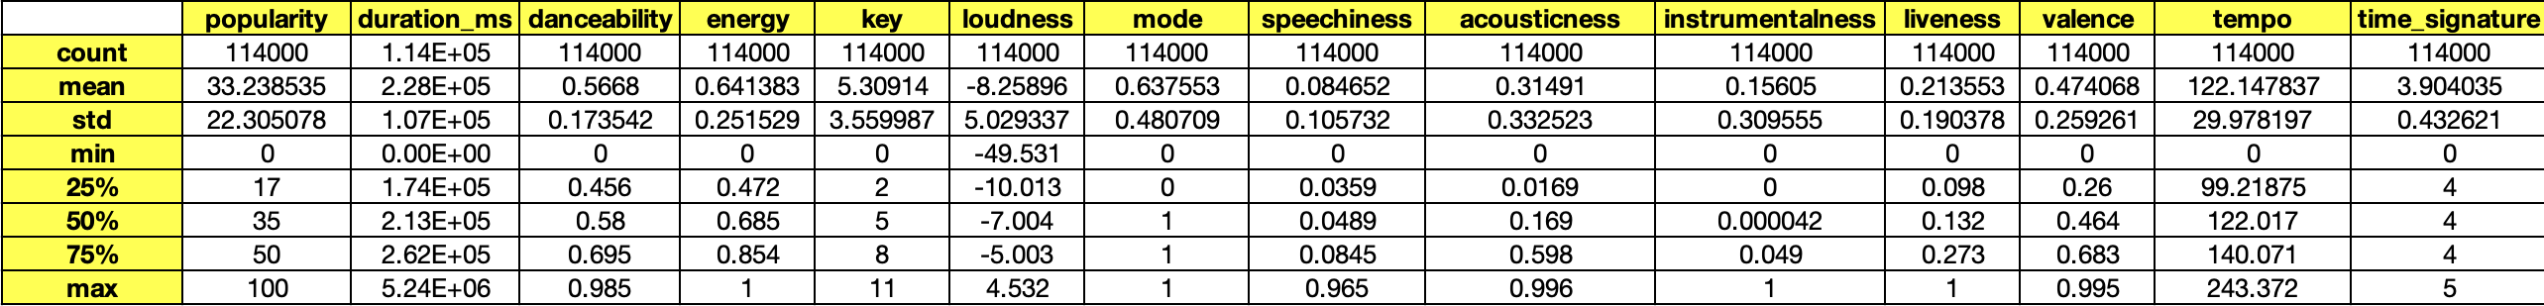
05
SSSK
Our Team
Agenda
Introduction
Data Description
Aims and
Objectives
Dataset
EDA
#
Title
Tasks
Events
Recommendation
System
Key Insights
Conclusion
Future Scope

Slide 8
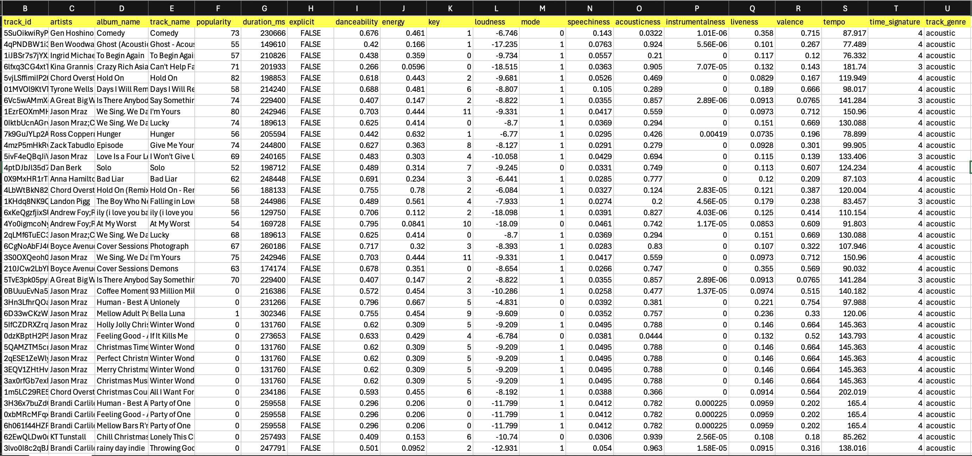
06
SSSK
Our Team
Tabular Data
Agenda
Introduction
#
Title
Tasks
Events
Aims and
Objectives
Dataset
EDA
Recommendation
System
Key Insights
Conclusion
Future Scope

Slide 9

07
SSSK
Our Team
Agenda
Introduction
Exploratory Data Analysis
Aims and
Objectives
Dataset
Exploratory Data Analysis (EDA) is the process of investigating and summarizing data sets to understand their main characteristics, often with visual tools.
It’s a critical first step in data analysis and machine learning, where analysts “explore” data to uncover patterns, spot anomalies, test assumptions, and check for relationships between variables.
It involves examining the data structure, loading the dataset, cleaning and removing null values and applying appropriate plots for visualization to infer key insights.
EDA
Recommendation
System
Key Insights
Conclusion
Future Scope

Slide 10
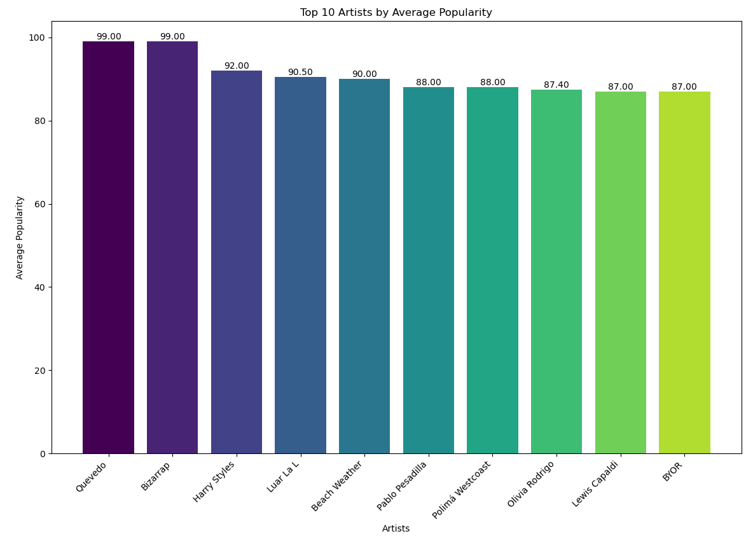
08
SSSK
Our Team
Top 10 Artists by Popularity
Agenda
Introduction
Aims and
Objectives
Dataset
The x-axis lists the artists' names, while the y-axis represents their average popularity scores.
Artists Quevedo and Bizarrap share the highest average popularity score of 99, followed closely by Harry Styles at 92.
The chart indicates which artists are the most popular, reflecting their significant influence and presence in music streaming and user listening preferences.
EDA
Recommendation
System
Key Insights
Conclusion
Future Scope

Slide 11
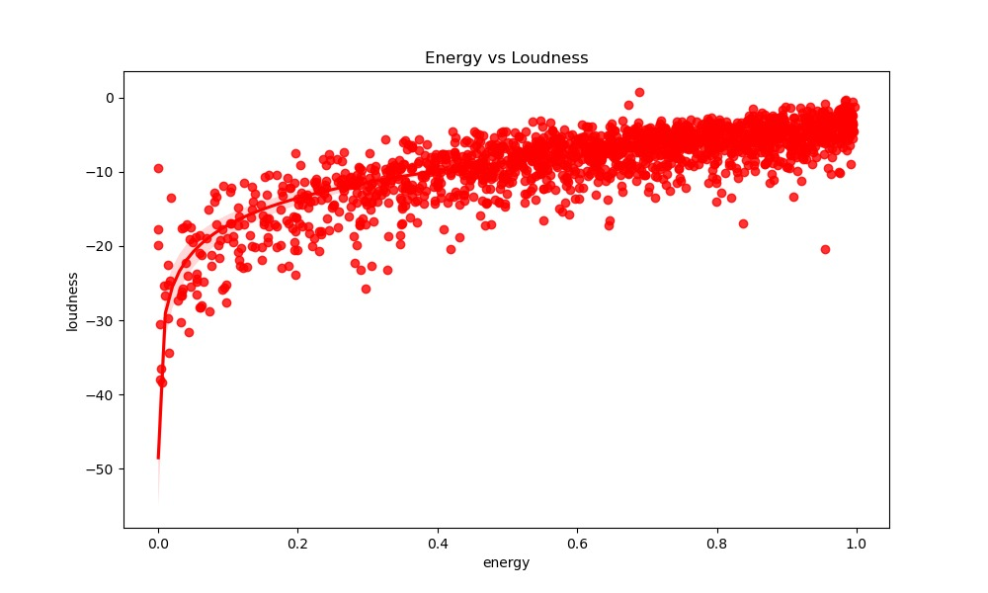
09
SSSK
Our Team
Energy Vs Loudness
Agenda
Introduction
Aims and
Objectives
Dataset
This graph shows the relationship between energy and loudness in our music dataset.
It is evident that there is a positive correlation between both the attributes.
This trend indicates that lower-energy tracks have a steep increase in loudness, while high-energy tracks stabilize at higher loudness levels
EDA
Recommendation
System
Key Insights
Conclusion
Future Scope

Slide 12
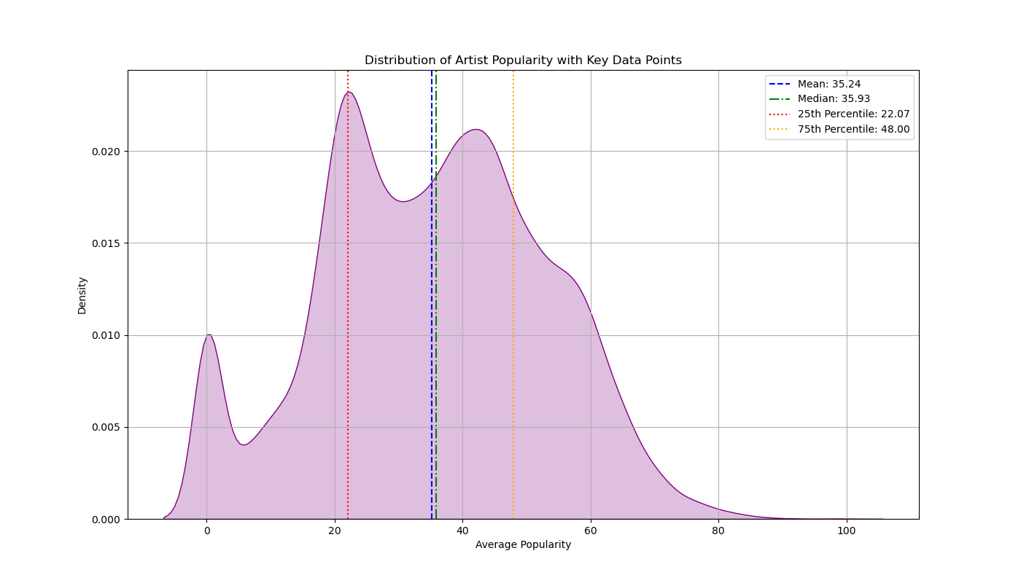
10
SSSK
Our Team
Density Plot representing Artists by Popularity
Agenda
Introduction
Aims and
Objectives
Dataset
This trend indicates that lower-energy tracks have a steep increase in loudness, while high-energy tracks stabilize at higher loudness levels
Most artists fall into the mid range of 20-50 indicating a clear separation between mainstream and niche artists.
Mean and median are very close (35.24 vs 35.93) indicating significant popularity variation in the dataset
EDA
Recommendation
System
Key Insights
Conclusion
Future Scope

Slide 13
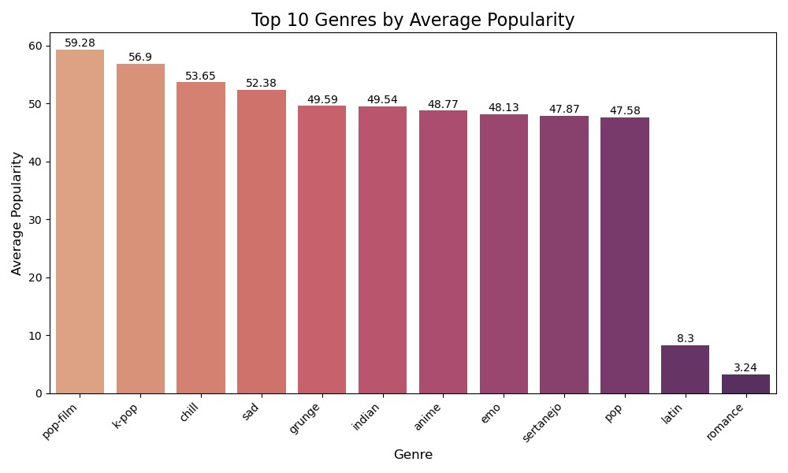
11
SSSK
Our Team
Top 10 Genres by Average Popularity
Agenda
Introduction
Aims and
Objectives
Dataset
Pop-film has the highest average popularity at 59.28, indicating it’s currently the most popular genre.
Other popular genres include K-pop, chill, and sad, all with average popularity above 52.
Genres like Latin and romance are much less popular, with romance having the lowest average popularity at 3.24.
EDA
Recommendation
System
Key Insights
Conclusion
Future Scope

Slide 14
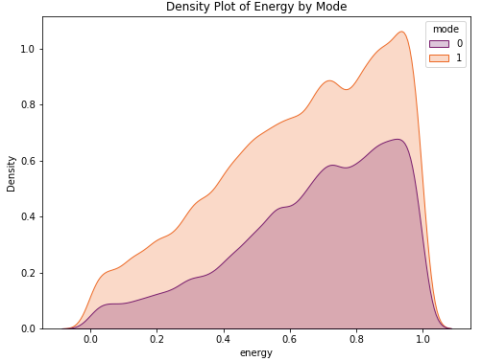
12
SSSK
Our Team
Density Plot of Energy by Mode
Agenda
Introduction
Aims and
Objectives
Dataset
This graph shows the difference in energy levels between two types of music: Mode 0 (purple) represents sad music.
Mode 1 (orange) represents happy music. The plot shows that happy music generally has higher energy levels, especially from 0.4 to 1.0 on the energy scale.
Sad music, on the other hand, has lower energy overall and doesn’t reach as high in this range. his graph helps us see that happy songs tend to be more energetic than sad songs.
EDA
Recommendation
System
Key Insights
Conclusion
Future Scope

Slide 15
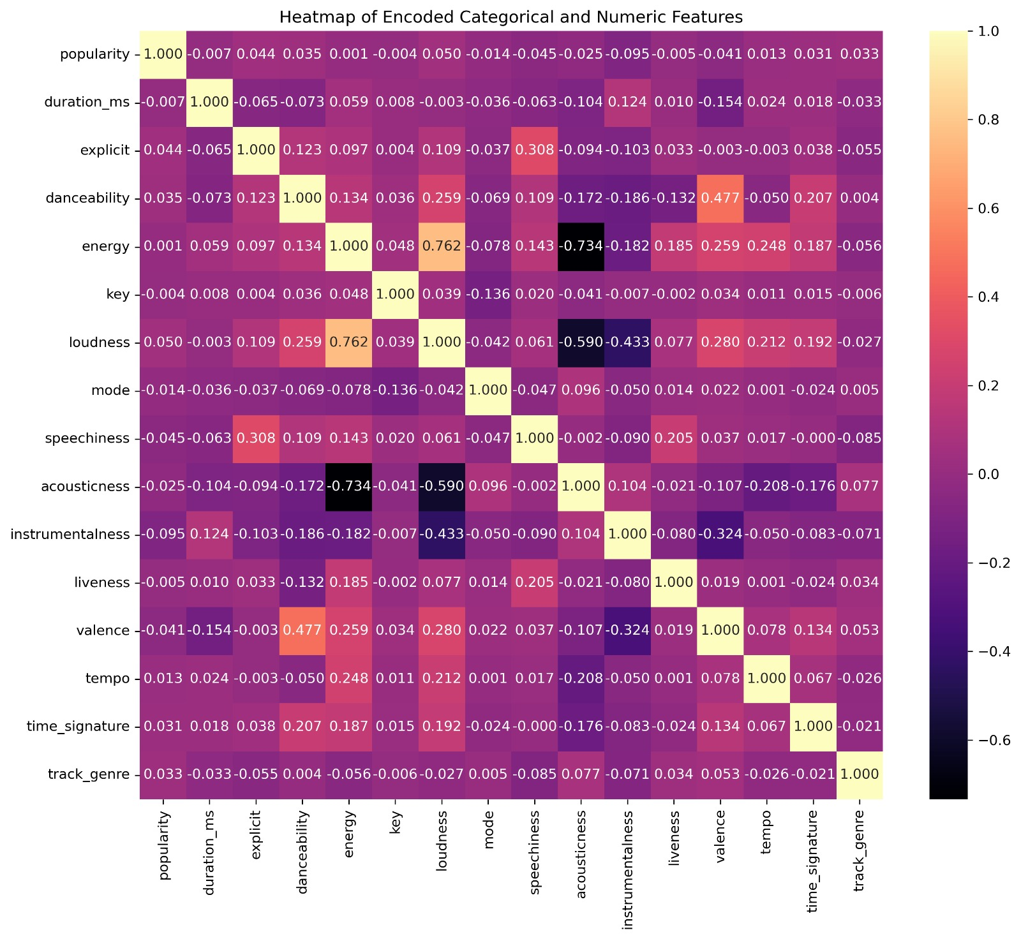
13
SSSK
Our Team
Agenda
Introduction
Aims and
Objectives
Dataset
EDA
Heatmap
Recommendation
System
Key Insights
Conclusion
Future Scope

Slide 16

14
SSSK
Our Team
Recommendation system
Agenda
Introduction
Aims and
Objectives
Collaborative
Filtering
Dataset
Collaborative filtering approach uses both user-based and item-based techniques to recommend music.
1.)User-based filtering suggests songs liked by users with similar preferences
2.)Item-based filtering recommends songs that are similar to the ones a user already enjoys
EDA
Recommendation
System
Key Insights
Conclusion
Future Scope

Slide 17
14
SSSK
Our Team
Recommendation system
Agenda
Introduction
Aims and
Objectives
Collaborative
Filtering
Content-Based
Dataset
Collaborative filtering approach uses both user-based and item-based techniques to recommend music.
1.)User-based filtering suggests songs liked by users with similar preferences
2.)Item-based filtering recommends songs that are similar to the ones a user already enjoys
Recommends songs based on their audio features, such as genre, tempo, instrumentation, or lyrics. This method analyses the characteristics of songs a user likes and suggests songs with similar features
EDA
Recommendation
System
Key Insights
Conclusion
Future Scope

Slide 18
14
SSSK
Our Team
Recommendation system
Agenda
Introduction
Aims and
Objectives
Collaborative
Filtering
Content-Based
Hybrid Model
Dataset
Collaborative filtering approach uses both user-based and item-based techniques to recommend music.
1.)User-based filtering suggests songs liked by users with similar preferences
2.)Item-based filtering recommends songs that are similar to the ones a user already enjoys
Recommends songs based on their audio features, such as genre, tempo, instrumentation, or lyrics. This method analyses the characteristics of songs a user likes and suggests songs with similar features
Combine collaborative filtering and content-based filtering to get the benefits of both. These systems leverage both user behaviour and the intrinsic properties of the songs to provide better recommendations.
EDA
Recommendation
System
Key Insights
Conclusion
Future Scope

Slide 19
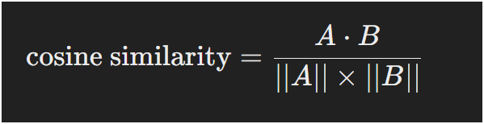
15
SSSK
Our Team
Cosine Similarity
Agenda
Introduction
Aims and
Objectives
Dataset
Cosine similarity is employed to measure the similarity between songs based on the vectorized feature data.
Cosine similarity is defined as the cosine of the angle between two non-zero vectors in an n- dimensional space, where a higher cosine similarity value indicates higher similarity between the vectors.
A similarity score of 1 means the users or songs are very similar, while a score of 0 means they have no similarity.
This helps in finding users with similar music tastes or songs with similar characteristics, aiding in accurate recommendations
EDA
Recommendation
System
Key Insights
Conclusion
Future Scope
where A and B represent two vectors

Slide 20
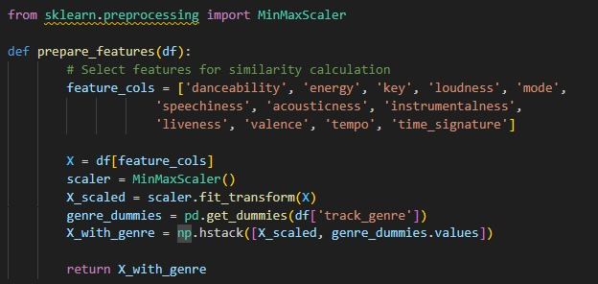
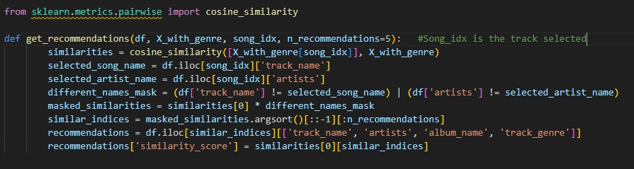
Cosine Similarity code
16
SSSK
Our Team
Agenda
Introduction
The function standardizes numerical features to ensure fair comparisons
It handles both numerical and categorical data
The output is a comprehensive feature matrix suitable for various analysis tasks
This preprocessing step is crucial for accurate music recommendations
Aims and
Objectives
Dataset
EDA
Recommendation
System
Key Insights
Uses cosine similarity for accurate music comparison
Filters out duplicate songs
Returns comprehensive information about each recommendation
Customizable number of recommendation
Conclusion
Future Scope

Slide 21

17
SSSK
Our Team
Agenda
Key Insights
Introduction
Aims and
Objectives
Dataset
We observed that the most popular song in the dataset was “Unholy” with popularity score of 100.
The most famous artists are “Quevedo” and “Bizarrap”, who share the highest average popularity score of 99.
Highest Energy was found in the "afrobeat" genre, suggesting a vibrant and high-energy style.
Longest Track was a song with a duration of approximately 3,600,000 milliseconds (~1 hour) from the "world-music" genre.
Loudest Track was measured at a loudness of -5.62 dB in the "trip-hop" genre.
EDA
Recommendation
System
Key Insights
Conclusion
Future Scope

Slide 22

18
SSSK
Our Team
Conclusion
Agenda
Introduction
Aims and
Objectives
Dataset
In conclusion, this music recommendation system successfully enhances music discovery by offering personalized song suggestions based on features like tempo, energy, loudness, and genre. Through effective data visualization, we created graphs and charts to analyse key audio features and infer insights that guided the recommendation process. The content-based recommendation algorithm, using cosine similarity, provided accurate and relevant song suggestions tailored to the user’s preferences. The system was deployed as an interactive Streamlit app, enabling users to explore music recommendations while visualizing song characteristics. This project highlights the potential for data-driven solutions to improve personalized music experiences, with opportunities for further refinement and expansion in the future.
EDA
Recommendation
System
Key Insights
Conclusion
Future Scope

Slide 23

19
SSSK
Our Team
Agenda
Future Scope
Introduction
Aims and
Objectives
Dataset
The system could integrate mood and emotion analysis to improve personalization, suggesting songs that align with or enhance the listener’s emotional state.
The recommendation system could be expanded to integrate with other streaming services or multimedia platforms.
Given the impact of music on mental health, the recommendation system could be used in therapeutic settings or wellness apps.
EDA
Recommendation
System
Key Insights
Conclusion
Future Scope

Slide 24




Thank You

